Slide 1

MCA Final Year Project
Title: Twitter(X) Sentiment Analysis Using Neural Networks.
Student Name: SHIVAPRAKASH.D.M
Register Number:22P01190
Guide Name: Ms.Uma Mageswari

Slide 2
CONTENTS
1.Abstract
2.Introduction
3.present and proposed system
4.tools
5.Requirements
6.module description
7.system design
8.Screen shots
9.future enhancement
10.conclusion

Slide 3

1.Abstarct
Sentiment analysis or opinion mining is the computational study of people's opinions, sentiments, attitudes, and emotions expressed in written language.
It is one of the most active research areas in natural language processing and text mining in recent years.

Slide 4
2.INTRODUCTION
Twitter sentiment analysis determines whether a tweet is positive, negative, or neutral. You can do it manually by analyzing each tweet and evaluating whether it is positive or negative.
It uses natural language processing and machine learning algorithms to classify tweets automatically as positive, negative, or neutral based on their content.
Sentiment analysis is used by data analysts in large companies to measure public opinion, track brand and product images, evaluate consumer experiences, and perform market research

Slide 5
3. PRESENT AND PROPOSED SYSTEMS:
Present Systems:
Twitter Sentimental Analysis is used to identify as well as classify the sentiments that are expressed in the text source.
Logistic Regression ,Neural Network and Naive Bayes are some of the ML algorithms that can be used for Twitter Sentimental Analysis with Python.
Description of neural network models used, such as Convolutional Neural Networks (CNN), Recurrent Neural Networks (RNN), or Long Short-Term Memory (LSTM).
Highlight the importance of hyper parameter tuning (learning rate, batch size) to improve model performance.

Slide 6
Proposed System:
Data Preprocessing and Feature Extraction:
Clean and tokenize tweets (removal of noise like special characters, URLs, and stop words).
Training and Fine-Tuning the Model
Split the dataset into training, validation, and testing sets.
Use techniques like batch normalization, dropout, and hyper parameter tuning (learning rate, batch size) to optimize model performance.
Evaluation and Performance Metrics
Measure accuracy, precision, recall, and F1-score for model evaluation.
Use confusion matrix and ROC curve to visualize model performance.

Slide 7
4.Tools:
Pandas
Numpy
Matplotlib and Seaborn
Sci-kit Learn.
Tensorflow and Keras
Natural Language Toolkit
Flask
Front End Technology(HTML5,CSS3)

Slide 8
5. Requirements
HARDWARE
Processor | Intel(R) Core(TM) i5-8365U CPU @ 1.60GHz 1.90 GHz
RAM | 8GB
HDD | 512GB
SOFTWARE
CLIENT SIDE TECHNOLOGIES | HTML, CSS
SERVER SIDE TECHNOLOGIES | PYTHON
DATABASE | -
WEB SERVER | RSET API
IDE | Visual Studio Code
TESTING & BUILD TOOLS | -

Slide 9
6.Module Description.
1. Data Collection and Preprocessing Module:
Collects tweets via the Twitter Dataset, cleans data (removes noise), and converts text into tokenized/ vectorized formats using techniques like word embeddings.
2. Sentiment Classification and Evaluation Module:
Classifies sentiments using neural networks and evaluates model performance with metrics like accuracy, precision, and confusion matrices.
3. Model Training and Optimization Module:
Trains the neural network model on the preprocessed data, optimizing using techniques like hyperparameter tuning, dropout, and batch normalization to improve accuracy and prevent overfitting.

Slide 10
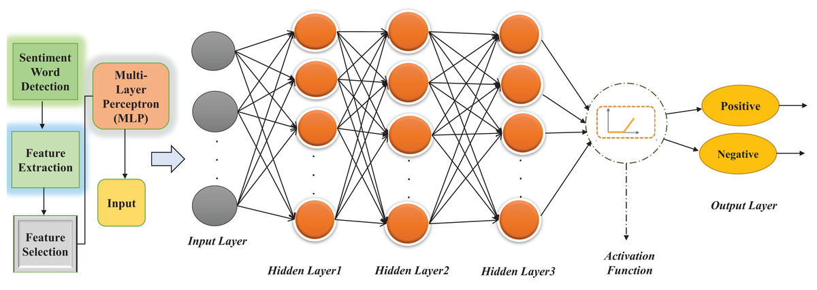
7.SYSTEM DESIGN
Data Flow Diagram

Slide 11
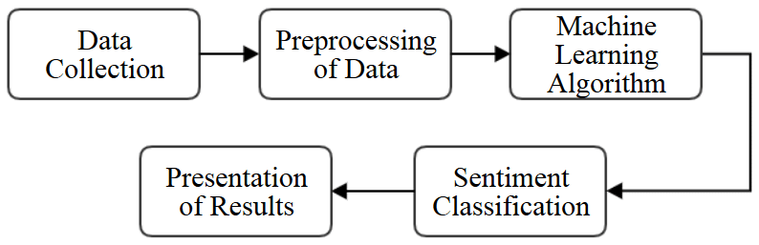
SYSTEM ARCHITECTURE

Slide 12
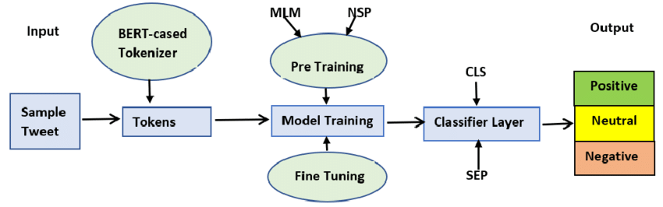
Block Diagram

Slide 13
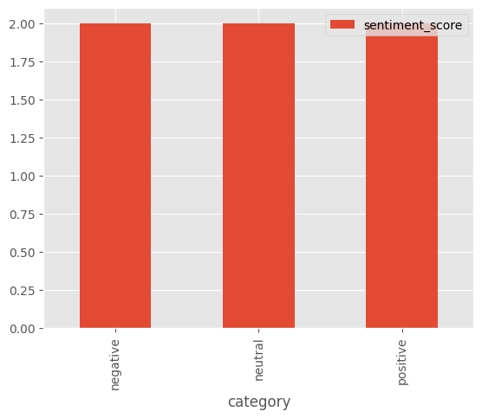
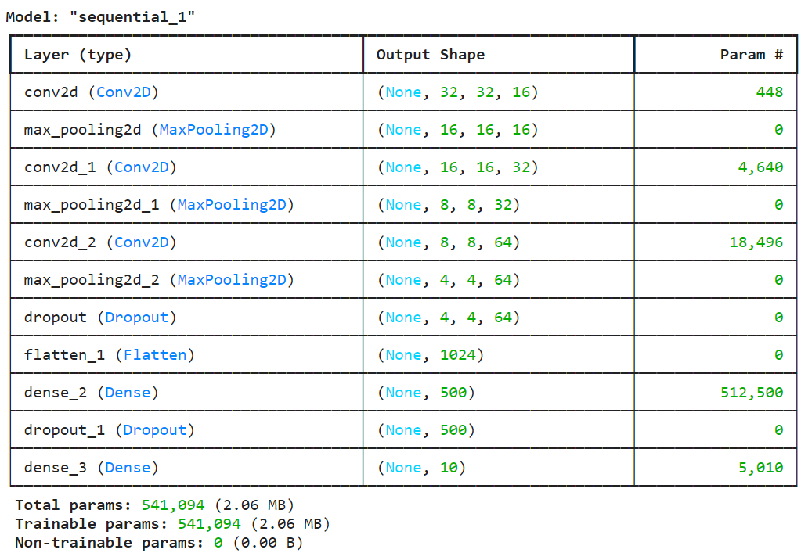
8. SCREENSHOTS
Distribution of Training Tweets:
Model Architecture:

Slide 14
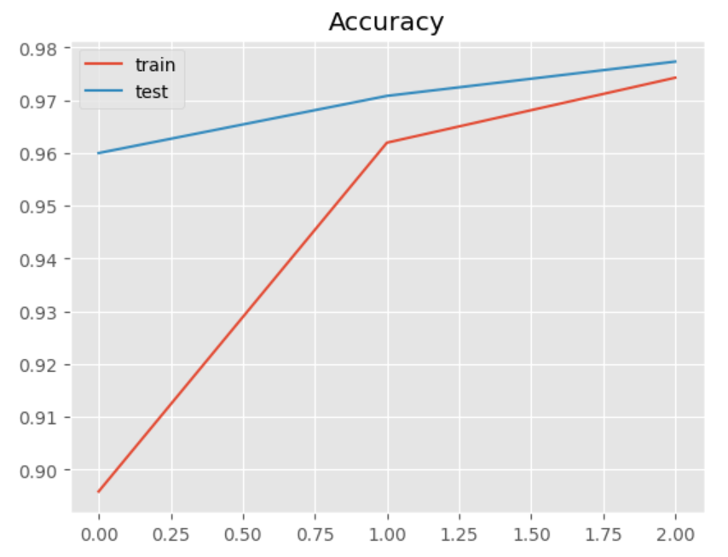
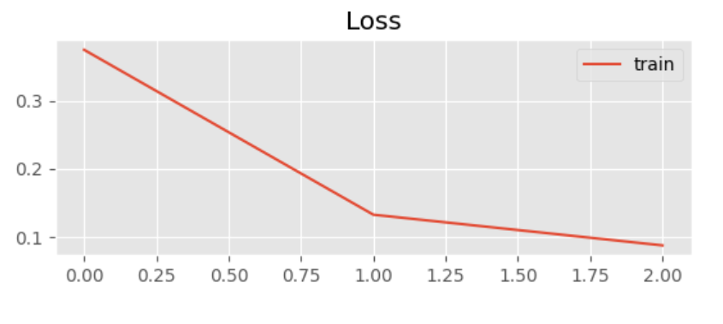
ACCURACY:

Slide 15
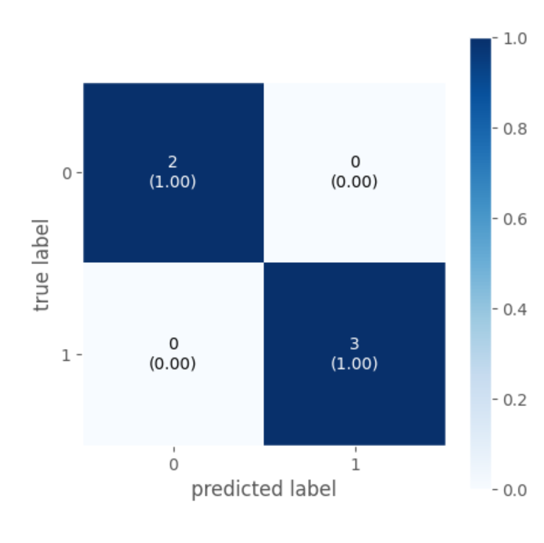
Confusion Matrix:

Slide 16
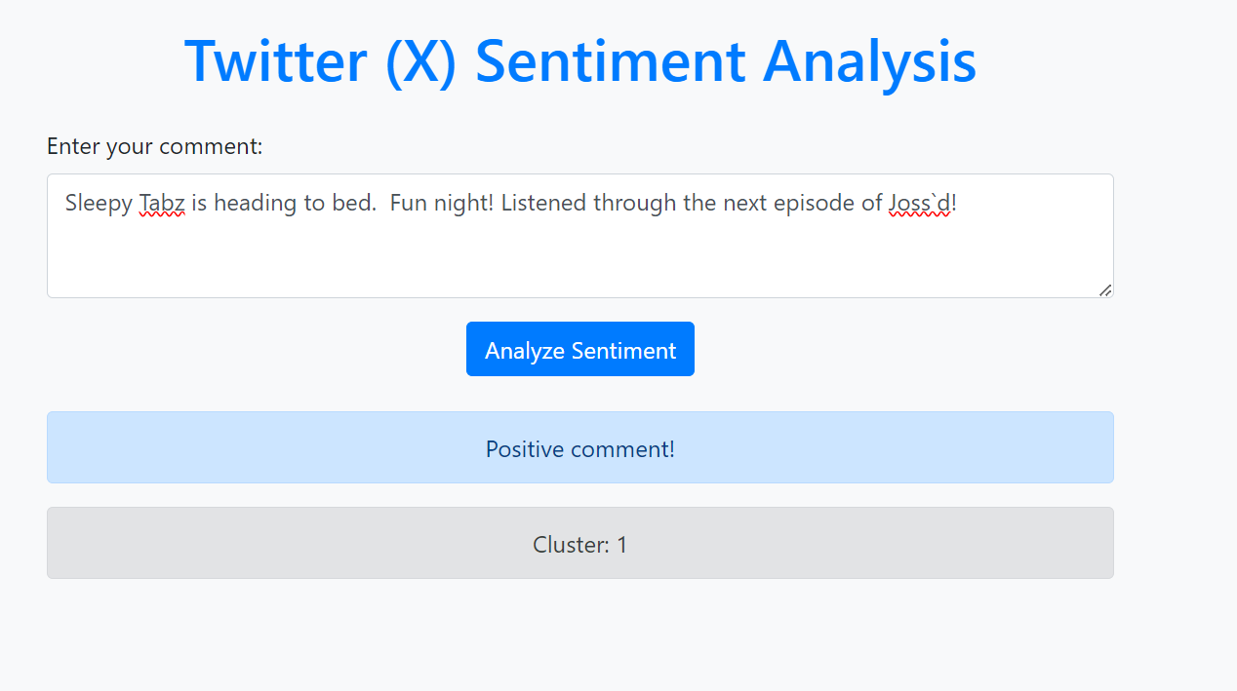
Positive Comment:

Slide 17
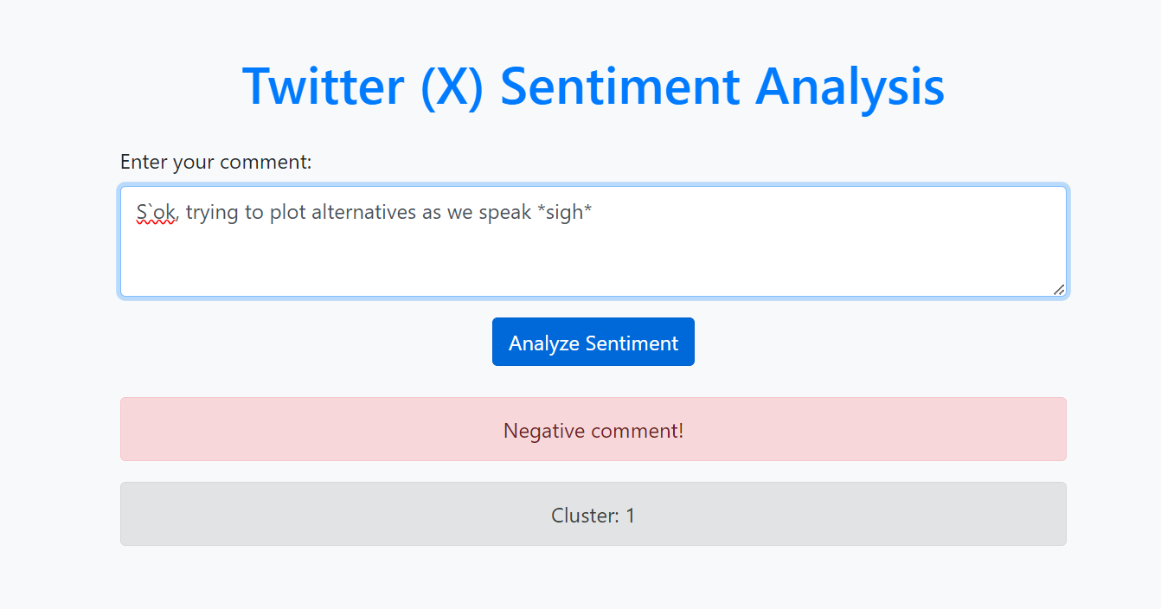
Negative Comment

Slide 18
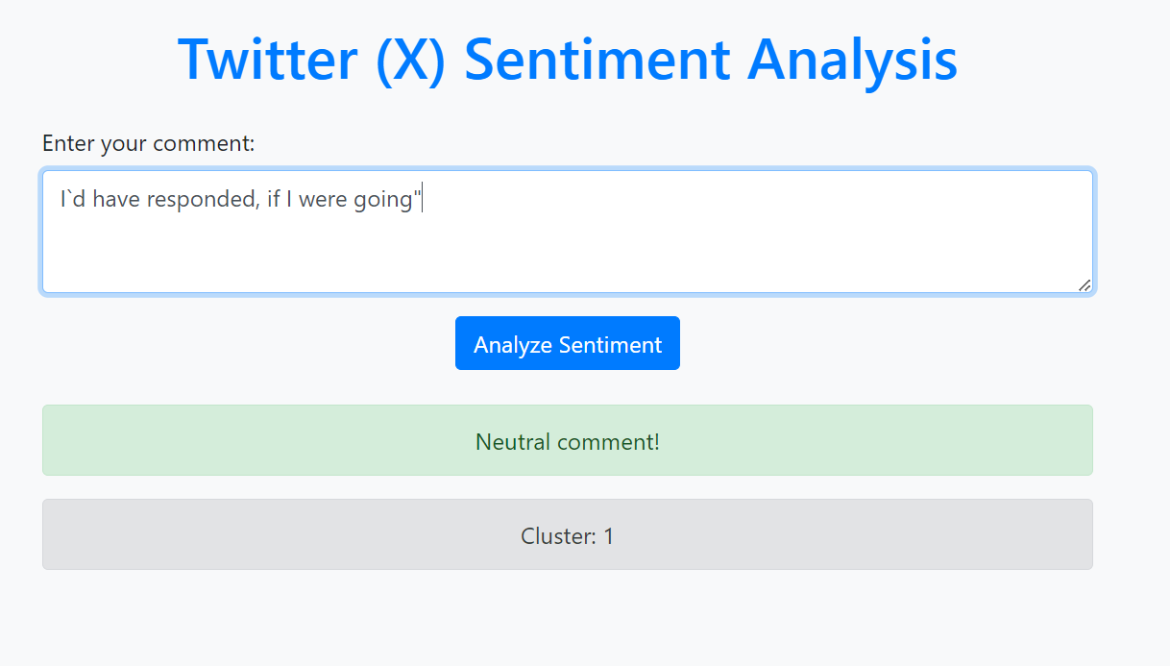
Neutral Comment:

Slide 19
9. FUTURE ENHANCEMENT
1.Real-time Sentiment Monitoring
Integrate real-time sentiment analysis by streaming live tweets using Twitter's API, enabling instant feedback and dynamic sentiment tracking for events or topics.
2.Emotion Detection and Topic Classification
Incorporate emotion detection (e.g., joy, anger, sadness) to provide more granular insights into user sentiment. Additionally, implement topic modeling to group tweets into specific themes or discussions.
3.Deployment as a Web-based Tool
Deploy the model as a full-fledged web application with a user-friendly dashboard, allowing users to visualize sentiment trends over time and filter tweets by sentiment, keyword, or date.
4. Incorporation of Multi languge Sentiment Analysis
Extend the model to support sentiment analysis in multiple languages, expanding the tool's applicability to global markets and enhancing its versatility.

Slide 20
10. CONCLUSION
Twitter Sentiment Analysis using neural networks leverages deep learning techniques to automatically classify the sentiment expressed in tweets, typically as positive, negative, or neutral. By utilizing neural network models like LSTM or CNN, the project captures the contextual meaning of words and handles the complexity of human language more effectively than traditional methods. This analysis provides valuable insights into public opinion, brand perception, or social trends by analyzing large-scale tweet data. The project offers potential for real-time monitoring and can be expanded to include multilingual sentiment, making it a powerful tool for businesses, researchers, and social analysts.

